Slide 1
Introduction to Robotics
CSE 461
Lecture 11: Introduction to Control System Theory (Part 2)
Niloy Irtisam
Lecturer, Dept. of Computer Science and Engineering
Brac University

Slide 2
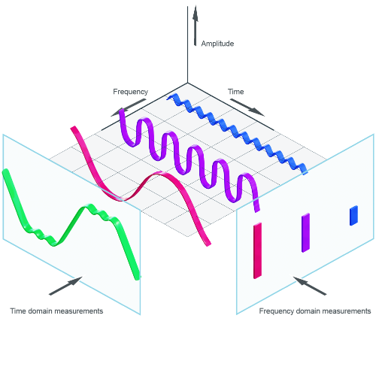
Time Domain to Frequency Domain

Slide 3
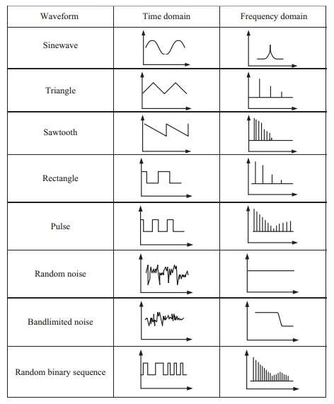
Signals

Slide 4
x(t)
x(s)

Slide 5
x(t)
x(s)
Laplace Transform

Slide 6
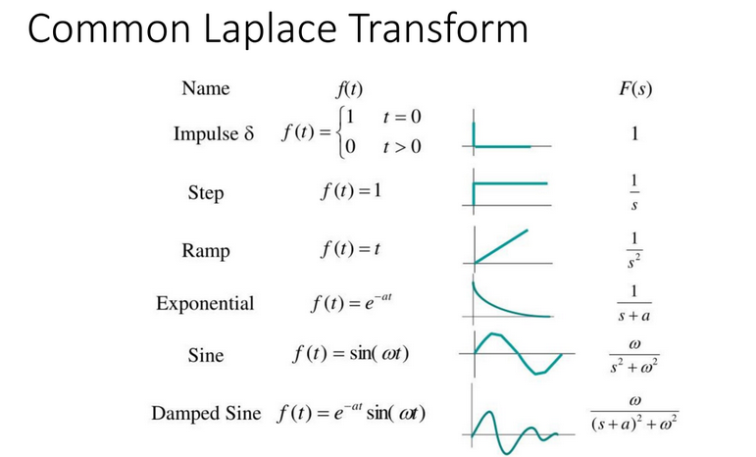

Slide 7
Block Diagram
G(t)
X(t)
Input
Y(t)
Output
Y(t) = X(t)*G(t)
Y(t)/X(t) = G(t)
Gain = Y(t)/X(t)= Output/Input

Slide 8
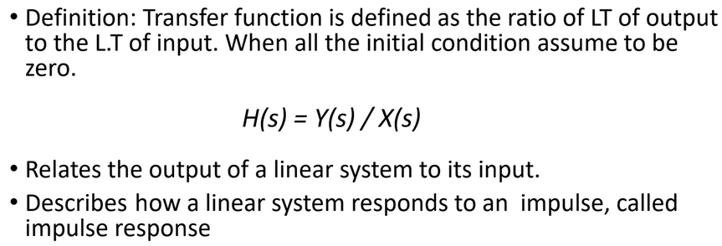
Transfer Function
H(s)
X(s)
Input
Y(s)
Output

Slide 9
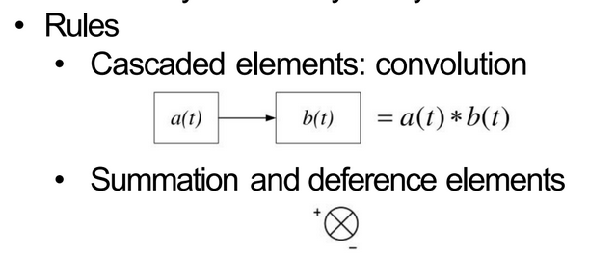
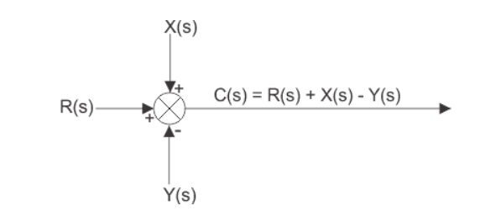
Block Diagram

Slide 10

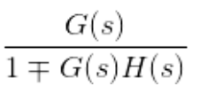
Feedback Connection
X(s)
G(s)
Y(s)
H(s)
*X(s)

Slide 11
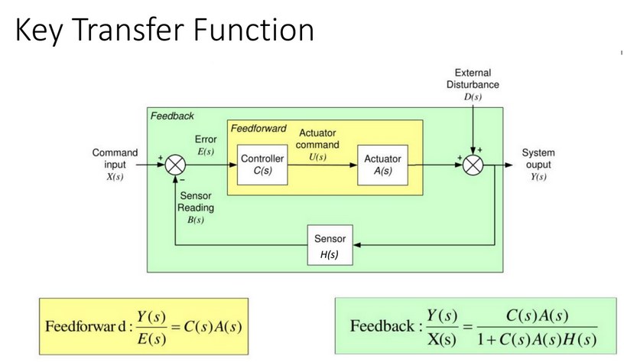

Slide 12
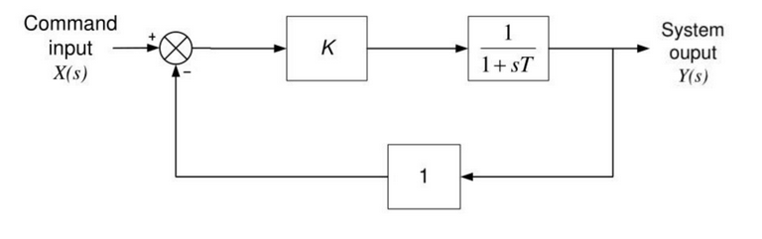
Transfer Function

Slide 13
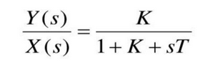
Transfer Function

Slide 14
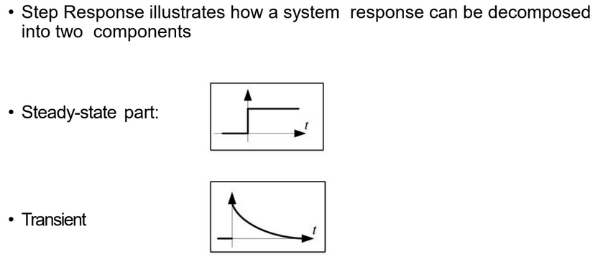
Steady State Vs Transient

Slide 15
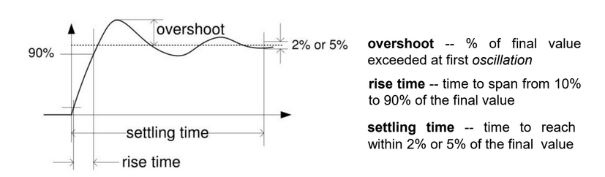

Slide 16
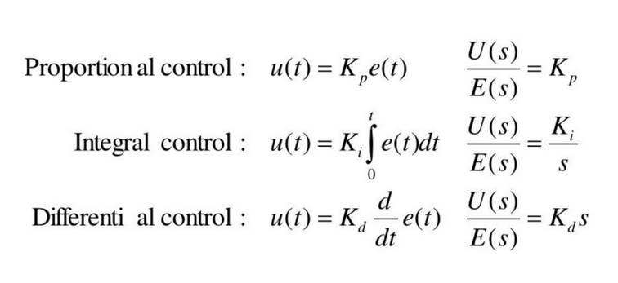
PID Controller

Slide 17
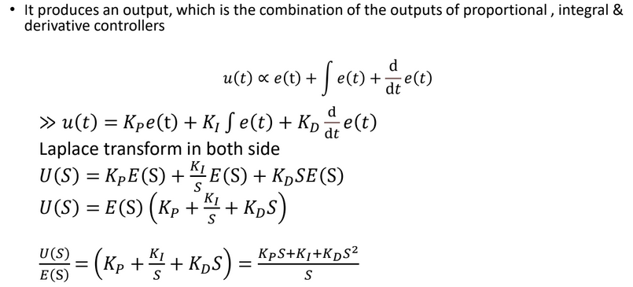

Slide 18
Effect of Controller Functions
• Proportional Action
Simplest Controller Function, The P term helps to reduce the steady-state error and improve the system's responsiveness. However, too high of a proportional gain can lead to instability and oscillations in the system's response.
• Integral Action
Eliminates steady-state error, The I term helps to improve the system's stability and eliminate any bias in the system. However, too high of an integral gain can lead to overshoot and instability in the system's response.
• Derivative Action (“rate control”)
Effective in transient periods, The D term helps to improve the system's stability and reduce the effects of disturbances in the system. However, too high of a derivative gain can lead to noise amplification and instability in the system's response.

Slide 19
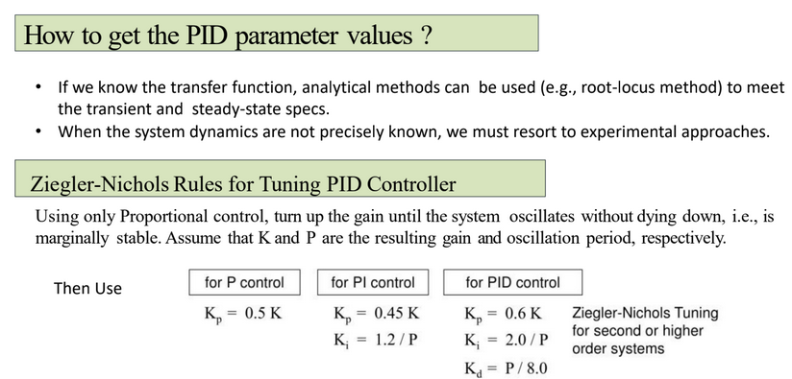

Slide 20
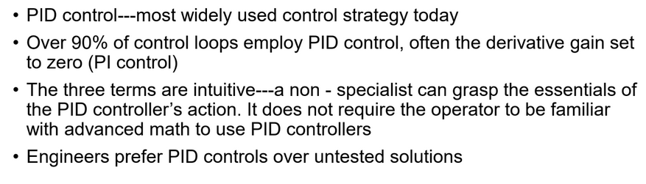

Slide 21
Next Class
Machine Learning

